Slide 2
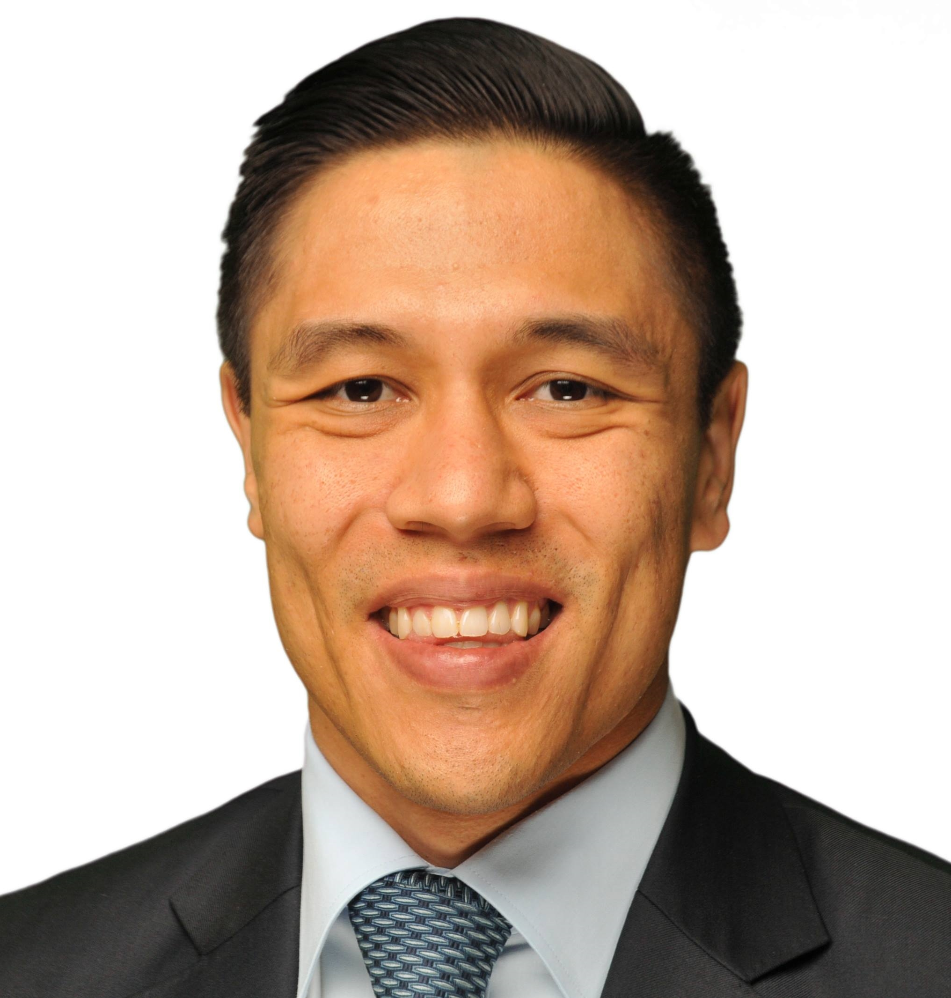
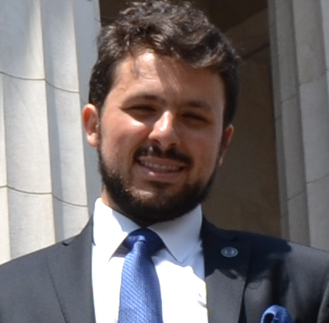
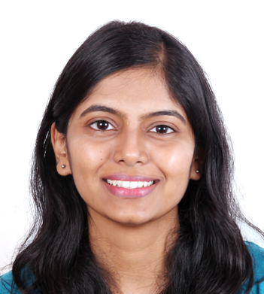

Team Introduction
Janul Hernandez
Diego Wolfsdorf
Anagha Todalbagi
Ryan Jang
NYU Stern MBA ‘17 Specialization: Data Science Contact Information: jh2609@stern.nyu.edu
Cornell Tech MEng ‘17 Specialization: [fill] Contact Information: daw284@cornell.edu
Cornell Meng IS ‘17 Specialization : [fill] Contact Information: at767@cornell.edu
NYU Stern MBA ‘17 Specialization: [fill] Contact Information: hrj26@cornell.edu

Slide 3

Table of Contents
Industry Dynamics
Current AML Problems
Our Solution
Demo
Challenges
Q&A

Slide 4
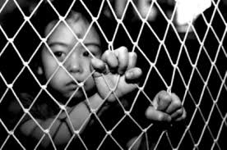


AML detection is a growing industry
$3.5 trillion passes through the market from money laundering annually - 80% of the world's illegal income.
Fraud Detection and Prevention market is expected to be $14 Billion in 2016 to $33 Billion by 2021, growing at 18%.

Slide 5
AML process is static and slow
Current anti-money laundering solutions are static with set scenarios and thresholds.
Current SARS reporting guidelines cast a wide net creating reports for innocent transactions leading to 9.4% refusal rates.
Machine Learning is being leveraged in credit risk analysis but not AML.

Slide 6
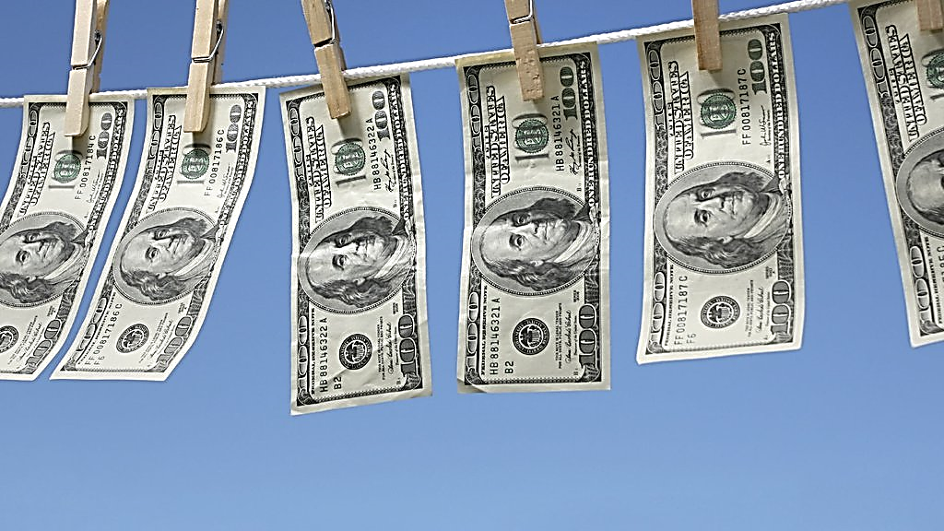
How might DUNS help institutional clients to detect money laundering more dynamically?

Slide 7
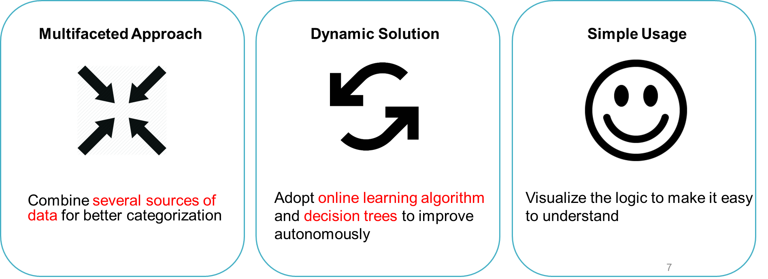
Project DUNS is your Data Science tool

Slide 8
Can project DUNS help banks detect Money Laundering?
Can we use Machine Learning (ML) to detect money laundering?
Gathered, cleaned, translated and joined data sets
Identified classifying characteristic. Ran data through ML.
Created prediction model and data visulization
Over 9 years of gathered transaction information from Czech Bank (1993-1999)
Total of 1,056,320 records
Looked at socio-economic, transaction, and sentiment events.
Used RCART and anomaly detection to build decision tree.
Dynamically set thresholds and scenarios
Visualized for easy interpretation of transaction flows.
8

Slide 9
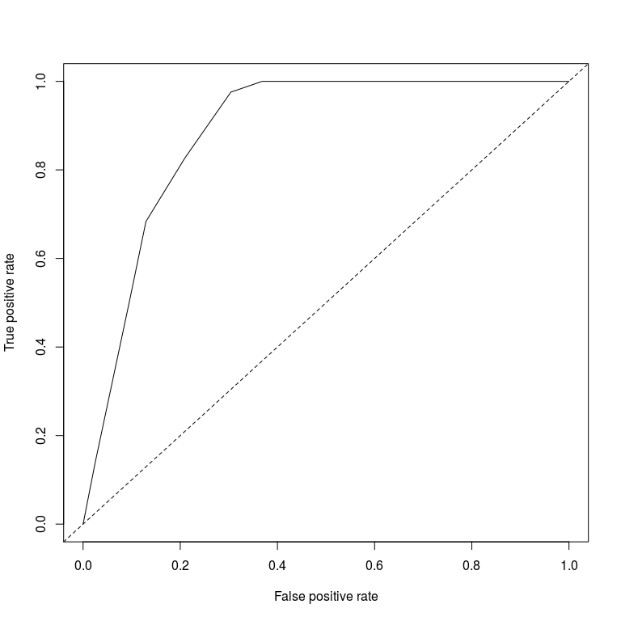
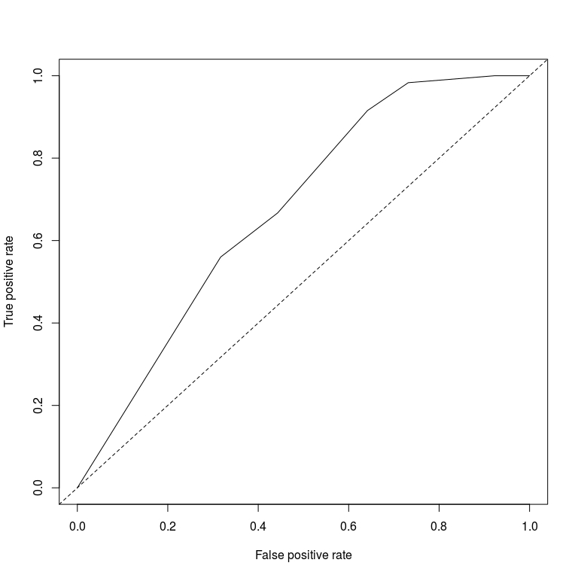
Results
DUNS algorithm flagged 33,637 of 321,351 with 88.54% accuracy.
Compared to automatic SARS generation according to FFIEC with 67.54% accuracy.

Slide 10
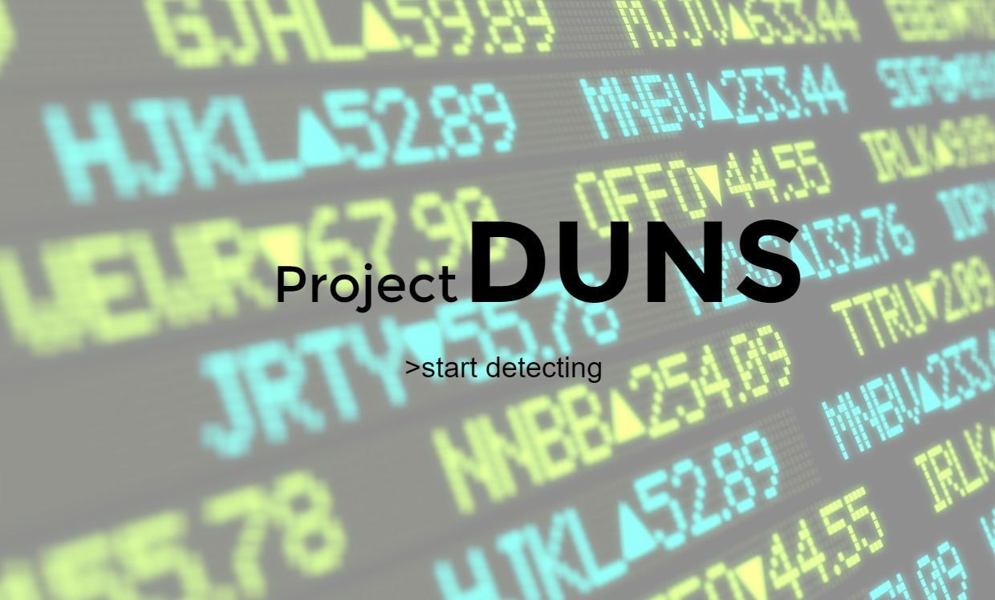

Slide 11
Challenges
Getting a real data set of banking transactions to test our algorithms on.
Ensuring algorithm creates models and predictions that make sense.
Building front end of project.

Slide 13
Federal Financial Institutions Examination Council: SARS Reporting
Currency activity including multiple transactions greater than $10,000.
Currency activity (single and multiple transactions) below the $10,000 reporting requirement (e.g., between $7,000 and $10,000).
Currency transactions involving multiple lower dollar transactions (e.g., $3,000) that over a period of time (e.g., 15 days) aggregate to a substantial sum of money (e.g., $30,000).
Currency transactions aggregated by customer name, tax identification number, or customer information file number.

Slide 14
